Slide 1
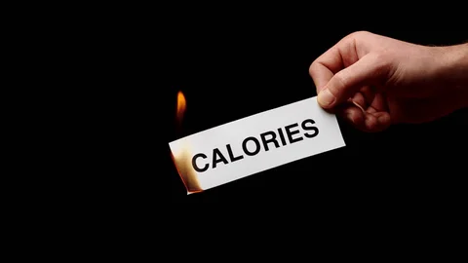
Calories Burnt Prediction

Slide 2

Abstract
This project focuses on developing a machine learning model to predict the number of calories burnt during workouts using biological and activity-based features such as age, gender, height, weight, and heart rate. The process includes data preprocessing, exploratory data analysis, and model training using algorithms like XGBoost for accurate prediction. The model helps in understanding how various factors influence calorie expenditure and can be integrated into fitness and health tracking applications to provide personalized insights for users.

Slide 3
Introduction
Machine Learning offers powerful tools to efficiently predict real-world outcomes. In this project, we utilize a dataset containing workout activities and biological parameters such as age, weight, height, and heart rate to predict calories burnt during exercise. Various Python libraries including Pandas, NumPy, Scikit-learn, and the Streamlit framework are used for data preprocessing, model development, and interactive visualization. The model provides accurate calorie predictions and demonstrates how data-driven approaches can enhance fitness tracking and health monitoring applications.

Slide 4
Objective
To develop a machine learning model that predicts the number of calories burnt during physical activities using biological and activity-based data.
To perform data preprocessing and exploratory data analysis (EDA) for better understanding of key factors affecting calorie burn.
To apply and evaluate machine learning algorithms like XGBoost for accurate and efficient prediction.
To build an interactive Streamlit application for real-time calorie prediction and user-friendly visualization.

Slide 5
Proposed Model
The proposed model aims to predict the number of calories burnt during workouts using machine learning techniques. The system takes biological inputs such as age, gender, height, weight, and heart rate, along with activity duration, to train a predictive model. The process begins with data preprocessing to clean and normalize the dataset, followed by exploratory data analysis (EDA) to identify important features influencing calorie burn. The XGBoost algorithm is then used to build an accurate and efficient prediction model. Finally, the model is integrated with the Streamlit framework, providing an interactive interface for users to input their details and instantly view their predicted calorie expenditure.

Slide 6
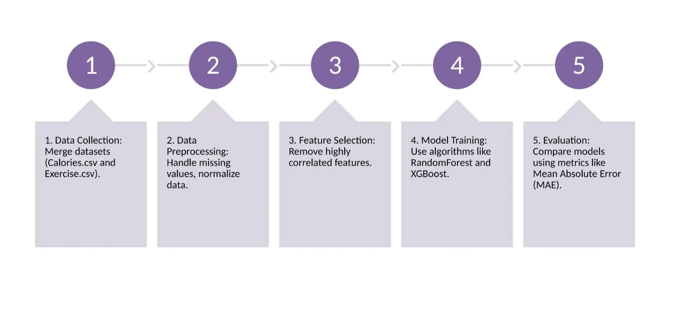
Proposed Model Architecture

Slide 7
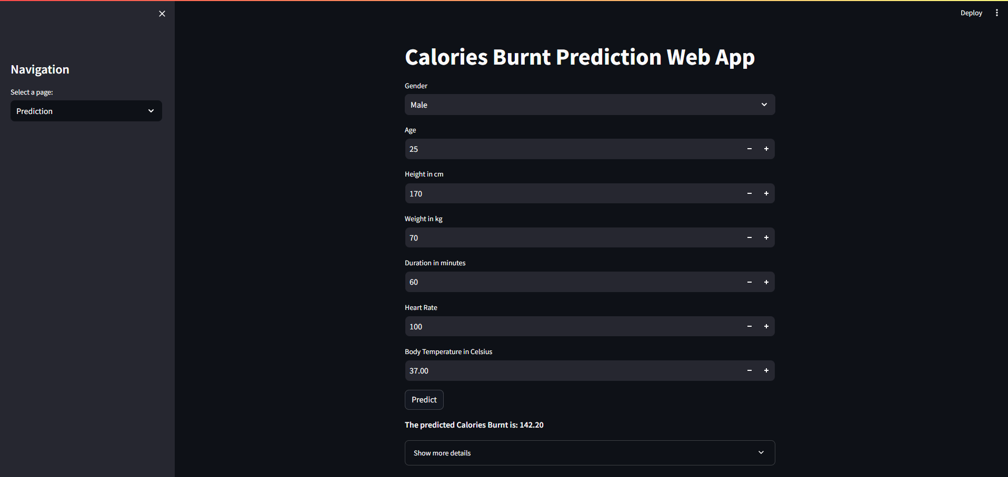
Output

Slide 8
References
Numpy : It used for numerical computing and data manipulation. It provides fast, efficient operations on large arrays and matrices of numerical data.
Pandas : It used for data analysis and manipulation. It provides flexible data structures and powerful tools to handle structured data easily — especially useful for data science and machine learning tasks.
MatPlot : It used for data visualization. It allows you to create static, animated, and interactive plots to better understand data trends and patterns.
Sklearn : Scikit-learn is probably the most useful library for machine learning in Python. The sklearn library contains a lot of efficient tools for machine learning and statistical modeling including classification, regression, clustering and dimensionality reduction.
XGBoost : It is a powerful and efficient machine learning algorithm based on gradient boosting. It’s widely used for structured/tabular data problems (like classification and regression) and is known for speed, accuracy, and handling missing data well.
Streamlit : By using Streamlit you can quickly build and deploy powerful data applications. For more information about the open-source library, see the Streamlit Library documentation.

